Slide 1
Whack a Mole
Jack Crowley, Radhey Patel, Stacia Kolodziejski

Slide 2
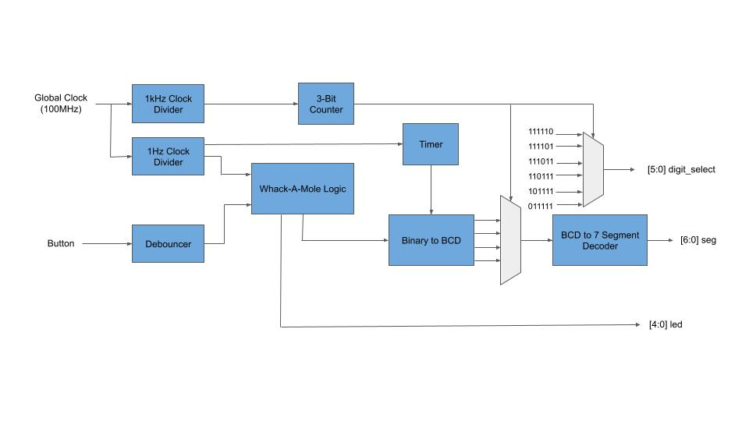
Block Diagram
**Reset not pictured

Slide 3
State Diagram

Slide 4
Modules
30 second timer
5 second timer
7 segment display
Debouncer
7 segment decoder
Binary to BCD module
2 bit counter
1 Hz clock
1 kHz clock
Whack a Mole Game
** Random number generator

Slide 5
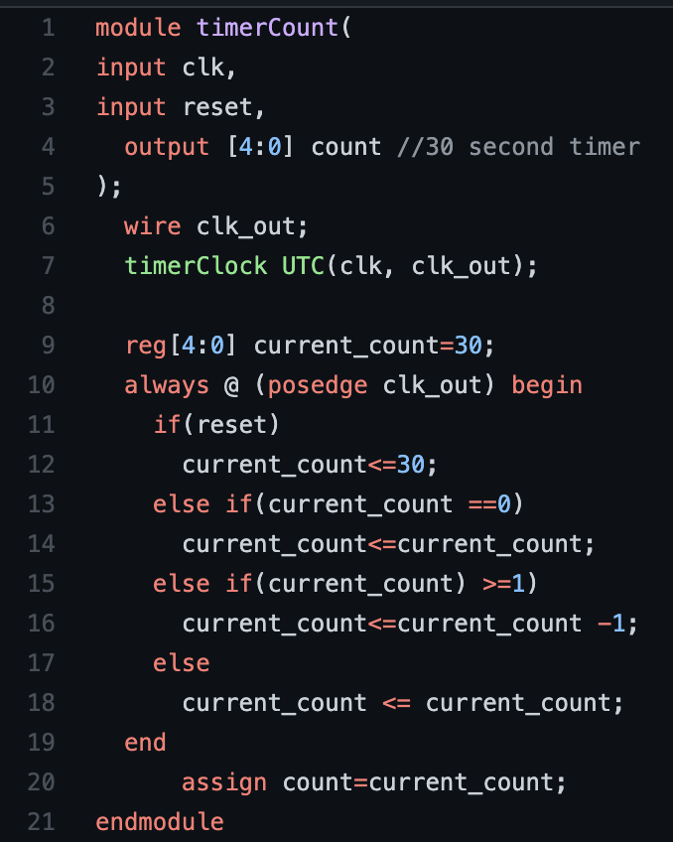
5/ 30 second timer

Slide 6
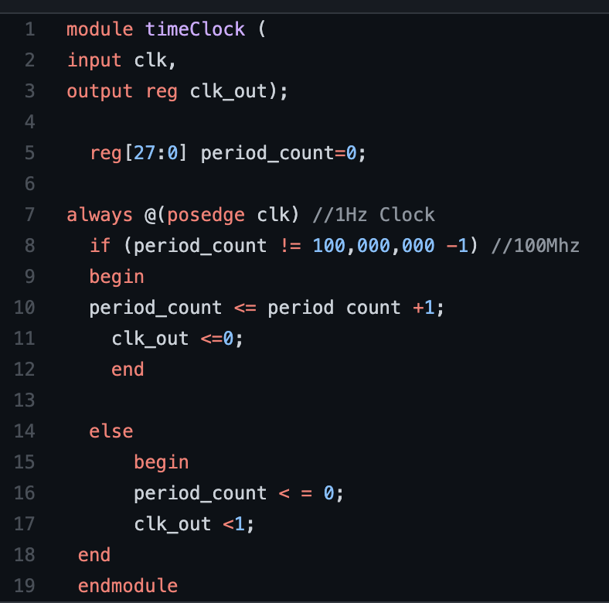
1 Hz Clock

Slide 7
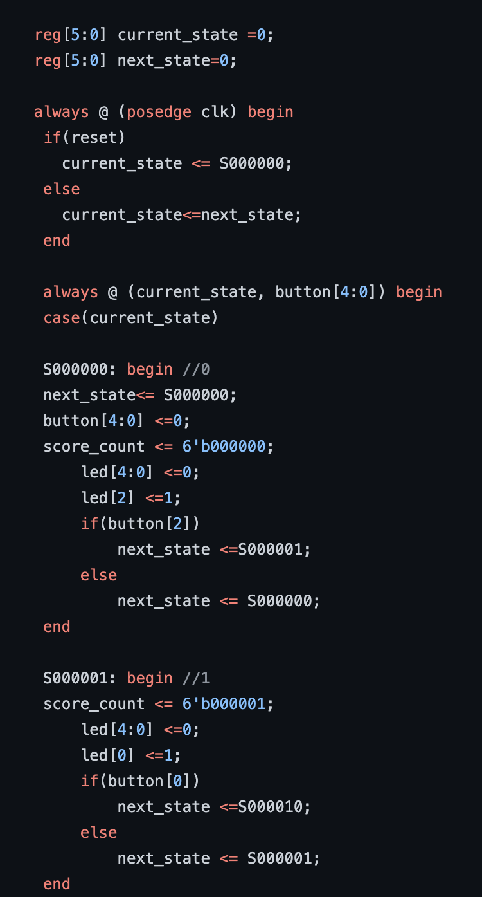
Whack a Mole Game

